Slide 1
G8/G20 JUSTICE
The Global Jubilee Movement for Debt Cancellation and Transformed International Financial System
Notes:
Hello everyone, thanks so much for joining us at this event to learn about the history of debt crises and to hear a little bit about the G8 and G20 summits that will be happening this year.
Welcomes

Slide 2
Outline of presentation
Debt History and Jubilee
Successes and Struggles
South to North
G8/G20 and an international bankruptcy court
Collective Action Steps
Notes:
Now that we have completed the 4 corners exercise and we have thought about our opinions on some of these issues, we will move on to this powerpoint presentation.
Real quickly – lets go over the main ideas that I will be presenting.
First we will be talking about the history of debt problems and their impacts on poverty and the developing world. I will discuss how the global Jubilee movement was born, what we have fought for, and our successes and continued struggles for global economic justice!
I will also be touching on how the debt crisis, historically understood to be affecting the developing world, also called the Global South, has now spread to the developed nations, also called the Global North. The reality that the debt crisis faces the entire globe makes the efforts for a new mechanism for debt cancellation all the more relevant and essential for the global economy.
After we discuss these connections I will explain what the G8 and G20 summits are, and what needs to be done this year to help push for debt cancellation by examining Jubilee USA’s push for an international bankruptcy court.
Finally I will end with some immediate actions steps we can collectively take together!

Slide 3

Debt History
Origins of Developing World Debt Crisis
Notes:
First, lets examine the debt crisis history.
The debt problems in the developing world began in the 1960s and 1970s when Western banks received an influx of cash from recently wealthy oil countries. They began to lend this money out to developing countries with little concern as to what the money would be used for and whether or not the countries would be able to pay the loans back, or if they were being given to dictators!

Slide 4
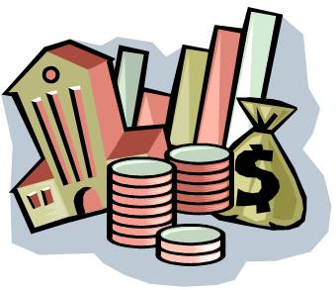
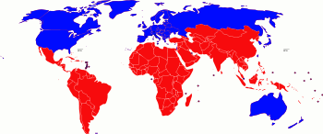
Debt History
Money lent from Global North to Global South in the form of loans.
Notes:
This is how finance works. When the economy is doing well and banks have lots of money they give out more loans, and at that time developing countries were a new location for lending! Developing countries took these loans for a variety of reasons.
Some took loans to build infrastructure. Some took loans to improve living standards for their people. Some dictators took out loans and used them to repress their own communities. Others had already taken loans and took on more loans to pay off previous debts and to take advantage of low interest rates which existed at this time.
Unfortunately, due to the irresponsible ways in which this money was lent and borrowed, much of this money failed to produce any results. Some money went to projects that were not only impossible but also corrupt.
Pictures:http://fortheluls.com/tag/bank/
http://www.absoluteastronomy.com/topics/North-South_divide

Slide 5
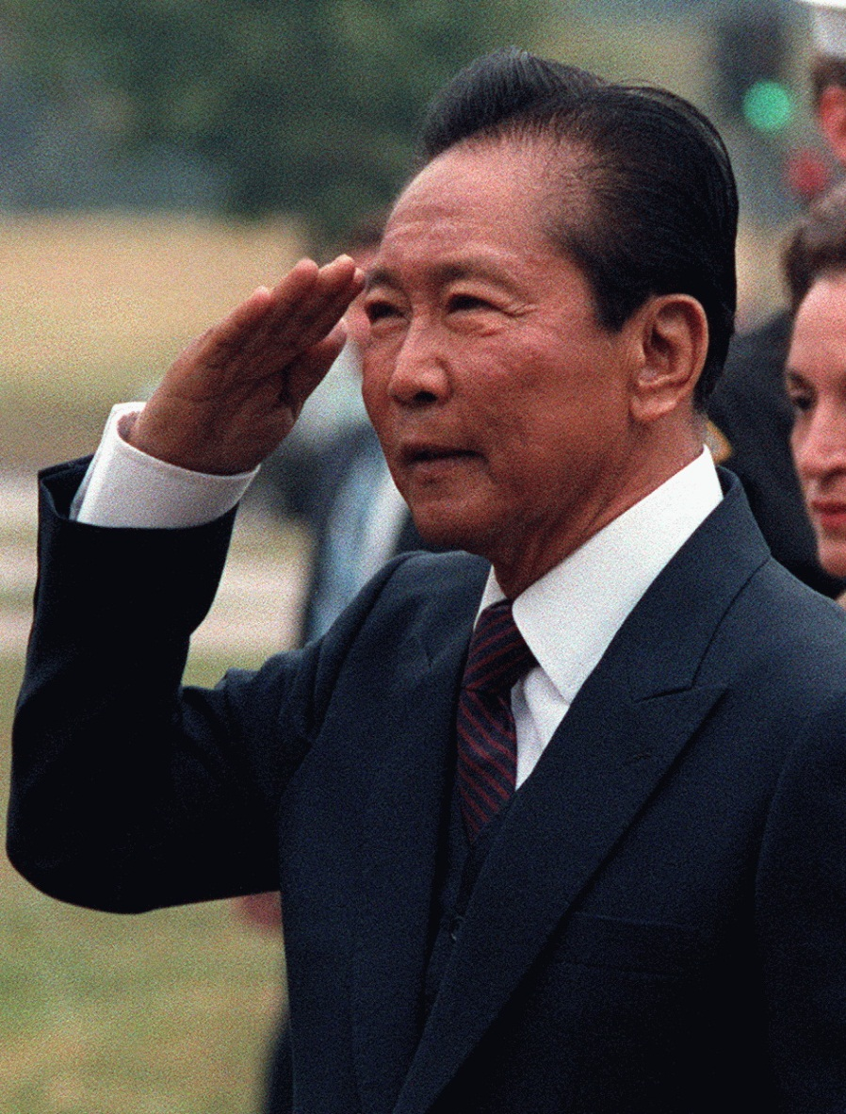
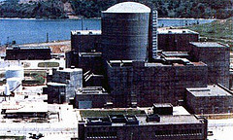
Debt History
One example of failure
Philippines: The Bataan nuclear power plant (above) and dictator Ferdinand Marcos (left)
Notes:
For example, in the 1970’s, in the Philippines, Marcos the dictator took out loans to help develop the Bataan nuclear power plant. His cronies and a US company earned huge profits – however, no one seemed to notice or care that it had been built on top of an earthquake fault line. The plant cost billions of dollars to build but can never be used. And it was not until 2007 that the debt was paid back by the citizens of the Philippines, despite the clear injustice.
There are other examples where loans went to buy arms and shore up oppressive regimes, giving them more resources to repress the voice of the people and democracy, for example in Egypt or the Democratic Republic of Congo. And in some cases, money lent to democratic nations was used irresponsibly or only benefited multinational corporations.
Pictures:http://www.phillyimc.org/en/philippines-don%E2%80%99t-revive-monster-morong-bataan

Slide 6
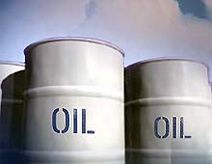

Debt History
How the Debt Crisis Began
Notes:
Besides many nations who became caught in debt by dictators, there are a number of other converges that caused wide-spread debt crises for most developing countries. First, as I said already, U.S. banks had lots of money and needed to lend it in the 1960’s. However, a decade later, the oil crisis of the 1970s caused a huge spike in prices across the entire global economy.
Developing countries depended on oil for their development to continue and it soon became too expensive to sustain, so growth slowed and made it more difficult for these countries to pay back their loans. Furthermore, the cash crops, such as coffee, that nations depended on and were pushed to produce by the same lenders and international financial institutions, faced a huge decline in their value due to a large increase of production and corporate control! This decreased the prices all countries expected to earn from their products they were selling.
Meanwhile, due to the oil crisis, loans which had initially had low- but variable- interest rates, suddenly witnessed a sharp rise in interest rates. As interest rates rose, larger and larger sums of money were owed, even as economic output declined!
Pictures:http://homes-for-sale-paloalto-today.com/blog/mortgage-interest-rates-in-palo-alto-nationally-heading-higher/
http://www.lilith-ezine.com/articles/politics/Hundred-Dollar-Oil.html

Slide 7
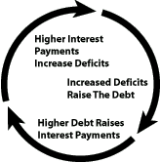
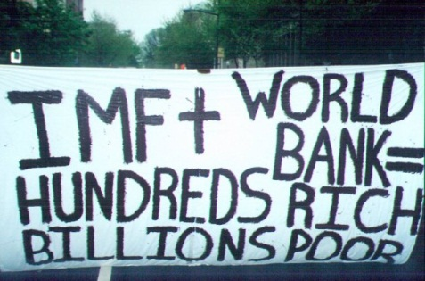
Debt History
Default and Disorder
Notes:
A watershed moment in this history of debt crises is when Mexico defaulted on its loans to creditors in 1982. Mexico had borrowed in part to repay other debts and gotten trapped in the debt cycle. This episode proved that a nation could default with disastrous consequences, and this shook the confidence of the financial system, as many countries were in similar situations.
Creditors banned together to create a system to restructure and reschedule payments. The International Monetary Fund (IMF) and World Bank stepped in with new loans to help pay the debts, initiating a whole new era of the debt cycle. Strict economic conditions attached to this lending made the situation even worse. These economic conditions included austerity measures such as cuts to social services and programs along with trade agreements that did not benefit Mexico. Unfortunately, these Structural Adjustment Programs, required for Mexico to receive loans in order to pay off unsustainable debts, set a precedent for how to deal with future debt ridden nations and crises.
Pictures: http://www.pakalertpress.com/2010/11/05/video-world-bank-imf-new-rulers-of-the-world/
http://www.greatreality.com/DebtFAQ.htm

Slide 8
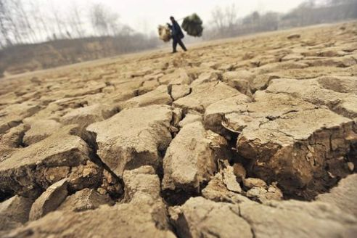
Debt History
Must we starve our children to pay our debts?"
-Julius Nyerere, former President of Tanzania
Notes:
As more and more nations entered into the debt cycle and into these loan agreements, debtor nations were forced to allocate huge sums of the national budget to paying off debts, or what is called debt servicing. By the 1980’s, debt servicing rose to one third of the government’s revenues in many developing countries, diverting funds from public investments in services such as health and education, which are essential to meet basic needs of communities that are already experiencing extreme poverty and for longer term societal benefit.
While the world’s poor in debtor nations were not receiving education, medical care or other basic human necessities, the wealthy lenders and banks in the developed world were still being paid back for unsustainable debts time and time over. In many cases, original debts had been paid back 10 times, but because of interest and continued lending, nations were still billions of dollars in debt. The former president of Tanzania summed up the unjust debt cycle when he said: "Must we starve our children to pay our debts?“

Slide 9
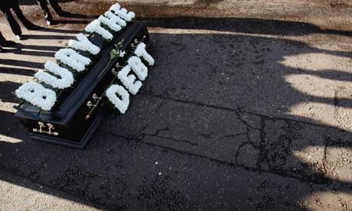
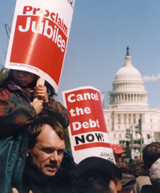
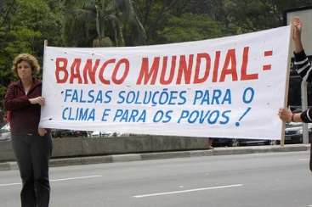
Global Jubilee Movement
Notes:
Global Jubilee Movement
In the last decades of the 20th century, country after country was succumbing to the woes of debt. Money continued to flow out to creditors instead of to the citizens that were in need of the most basic services.
We have to remember that there was, and remains, a striking power imbalance between the creditors and the debtors. The creditors hold all the power in lending and restructuring of loans. However, lender’s role in causing debt crises due to irresponsible lending and enforcing economic conditions, is often overlooked. The global Jubilee movement helped to begin reframing conversations and push for change to cancel these debts that were hurting the world’s poorest.
People in the Global South began a call for justice and a different system for handling these debts, especially after countries were freed from the reign of dictators. The groups in the South began to connect with the global North, particularly faith-based communities. More and more people around the world began to realize the injustice of international sovereign debt, launching the global Jubilee movement.
Pictures: http://www.climate-justice-now.org/world-bank-out-of-climate-campaign/
Guradian.co.uk
9

Slide 10
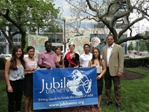
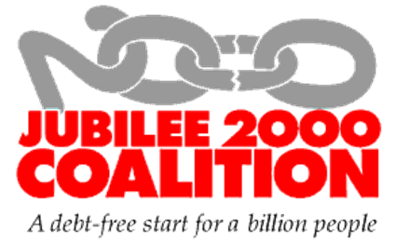
Global Jubilee Movement
“...proclaim liberty throughout the land to all its inhabitants; it shall be a jubilee for you.”
-Leviticus 25:10
Notes:
In 1997, the Jubilee 2000 coalition was created, based on the biblical call for debt forgiveness of a Jubilee Year. In Leviticus 25, every 50 years is to be a jubilee year in which people are forgiven of their debts, slaves are set free, and relationships between community members are restored and made whole. The movement quickly gained ground calling for a Jubilee in the year 2000.
Communities across Africa, Asia, Latin America, Europe, and the United States connected over this issue of justice and pushed to eradicate poverty through the cancellation of unjust debts. Communities lobbied government officials, delivered petitions, marched in the streets in massive protests and gained more and more momentum. Much of the pressure was directed at the World Bank and International Monetary Fund, the two largest financial institutions that helped to create and maintain the continued debt cycle of poverty.
Something that we should remember is that when people began to organize around these complex issues of debt two things were said. First, it was believed that the issues of debt and finance were too complicated for people to understand or to get involved in. And secondly, the financial leaders of the time believed that debt cancellation would destroy the international financial system.
Both of these beliefs were proven wrong. Millions joined the global Jubilee movement, and in the past decade, have successfully advocated for over $100 billion in debt forgiveness for nations across Africa, Asia, and Latin America!

Slide 11
Debt Relief Works
Nicaragua increased spending on health and education by $175 million in 2007-2008
In Tanzania, debt relief has provided funds to build schools and pay for resources and teachers, increasing school attendance by 50%
Many clinics have removed user fees, making it possible for people to seek treatment
Notes:
Debt relief is a viable option because it has been proven to work. Today, international financial institutions agree that debt relief provides larger benefits to human development. I’m going to read a few debt relief facts!
Facts:
-According to the World Bank, countries that have received debt cancellation have seen a 75% increase in spending on social services.
-Nicaragua increased spending on health and education by $175 million in 2007-2008
-Debt relief has had a direct impact on reducing child mortality.
-In Tanzania, debt relief has provided funds to build schools and pay for resources and teachers, increasing school attendance by 50%
-Many clinics have removed user fees, making it possible for people to seek treatment
-Ghana’s poverty rate decreased from 40% to 29% in the years following debt forgiveness

Slide 12
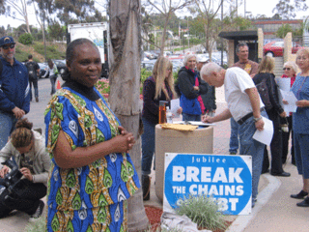
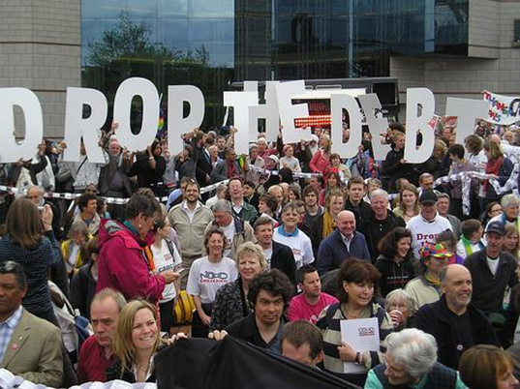
Continued Struggle
Making debt relief work better for everyone
Notes:
Despite successes, there are limitations to the way debt relief has been delivered. The most common mechanism for debt relief, called the Heavily Indebted Poor Countries (HIPC) Initiative, was developed through the International Monetary Fund as a way to provide debt relief- but only to countries that meet a standard of set qualifications.
For example, there is a stringent period of time that it takes to qualify once a nation agrees and is accepted into the initiative. In most cases, when entering into the initiative and in order to receive debt relief, a nation must also agree to various programs. These programs are similar to the original Structural Adjustment Programs, which cut social services or force nations to open up their economies more freely to multinational corporations and do not benefit the majority of the poorest people in the nation. The International Financial Institutions developed another mechanism, the Multilateral Debt Relief Initiative (MDRI), which similarly requires that countries meet set standards and implement austerity programs.
Additionally, these mechanisms do not address other forms of debt, known as “odious debt,” or debt that was knowingly given to a regime known to be corrupt. Odious debt would be, for example, the loan that was given to Marcos, the dictator of Philippines, for the failed nuclear power-plant. It is odious, or unjust, because, first, the lenders knowingly gave money to a brutal dictator. Second, loans were given and did not benefit the people.
Many agree that the HIPC and other initiatives currently used to cancel debt have not given a robust or strong enough mechanism for various nations to achieve justice. For example, the creditors continue to maintain control in the process of debt relief as opposed to working for more neutral ground. These and other concerns around the current debt cancellation are even more pressing and relevant today in our current global economic crisis.
12

Slide 13
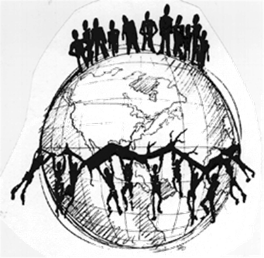
South to North
Debt Crises Spreads to the North…
…Followed by the False Solutions.
Notes:
This is because debt is no longer only a problem for the developing world. Despite extreme poverty, disparities, and global inequity – debt issues are now the norm for nations in the Global North and Global South.
Remember how I discussed how the U.S. banks’ lending practices as well as international financial institutions helped to start the first debt crisis.
Well, lets think back to 2008, when predatory and irresponsible lending to low income people and communities of color forced millions to go into foreclosure and caused the housing market to crash here in the United States.
Again, banks had lots of money and were seeing an increasing profit in the housing market. Banks continued to give loans to people they knew would be unable to pay back, at the same time as they invested and speculated on the loans and housing market. When homeowners defaulted and were subsequently evicted, there was also a chain reaction that plunged Wall St and then the world economy into recession -- the effects of which we are still dealing with today. In the case of the United States, banks got bailed out, while those who had lost homes lost everything. Once again, the lenders won.
Today in the news, we hear more and more about debt crisis, but this time its people in Europe who are struggling with this burden.
If you have been paying attention to the news, you already know about the recent financial crises in Greece, Ireland and several other European countries. The EU has been scrambling to pick up the pieces. These countries are much bigger players in the global economic realm, and because of their place in the European Union, these crises have widespread consequences.
As the debt crises spreads from the Global South to the Global North, we see the same false solutions enacted. More loans are being given to countries with unsustainable debt, with the same programs of austerity being attached. These SAPs will force countries like Greece to cut social services in order to pay off debts to banks in other countries. The financial decision makers are forcing governments to put the welfare of banks above that of its own citizens.

Slide 14
Debt Facts
With current solutions, Greece’s debts will still represent an unsustainable 120 per cent of the country’s GDP by 2020
It cost $200 billion to bail out Fannie Mae and Freddie Mac after the 2008 collapse. The whole of sub-Saharan African debt amounts to $173 billion.
Malawi: 40% of GDP is spent on debt servicing and only 15% on education and health combined
Indonesia: Acquired $150 billion in debt under dictator Suharto. The people are still paying back money used to enrich politicians, buy arms and oppress their rights.
Many countries pay more than double in debt servicing what they receive in aid
Notes:
Some interesting Debt Facts to consider around the connections, similarities, and differences between debt crisis in Europe and the Global South.
With current solutions, Greece’s debts will still represent an unsustainable 120 per cent of the country’s GDP by 2020
It costs $200 billion to bail out Fannie Mae and Freddie Mac after the 2008 collapse. The whole of sub-Saharan African debt amounts to $173 billion.
Malawi: 40% of GDP was spent on debt servicing and only 15% on education and health combined
Indonesia: Acquired $150 billion in debt under dictator Suharto. The people are still paying back money used to enrich politicians, buy arms and oppress their rights.
Many nations in the global south continue to pay more than double in debt servicing than what they receive in aid

Slide 15
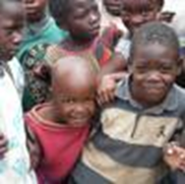
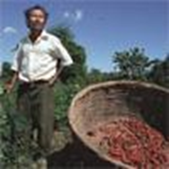
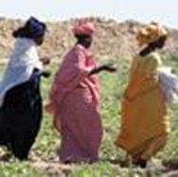
Breaking the Chains of Injustice
We need a better solution to debt
Notes:
The reality is that the spread of the debt crisis to the global North has highlighted the devastating effects of unsustainable debt, something the global south has struggled with for decades. Our economies continue to be increasingly connected, and these new debt crises occurring in the global North, and the threat of the impact in the developing world and for citizens already facing extreme poverty is a stark reality. A new and longer lasting solution to debt must be developed.
The Jubilee movement has consistently pushed Congress, as well as Republican and Democratic Presidential Administrations and has succeeded in past debt cancellation. Today, Jubilee USA is calling for a number of different solutions to the international debt crises, like implementing principles of Responsible Lending and Borrowing in the U.S. Congress as well as at the United Nations. These principles will help prevent future debt crises and build accountability on both ends of the creditors and lenders.
However, we need a better solution to the debt crises that continue to plague the global economy now – not just addressing loans and debt in the future! One avenue the Jubilee movement continues to work with to make changes is in the international summits, where leaders make decisions that affect the lives of billions of people. This brings us to the G8 and G20.

Slide 16
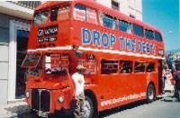
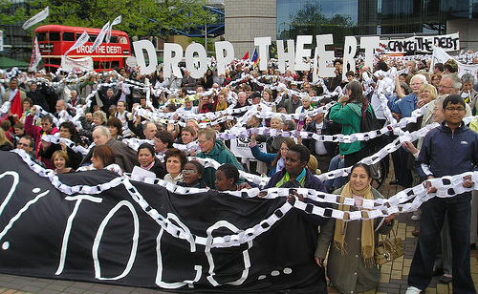
G8 /G20
G8 formed in 1975, G20 in 1999
Forum on economic and trade issues
First commitment to debt relief occurs at G7 (before Russia joins) in 1999
Notes:
Lets back up a second and talk about who and what the G8 and G20 are.
In 1975, representatives from the UK, US, France, Germany, Italy, and Japan gathered in France to discuss economic issues. Canada joined this group in 1976, followed by Russia in 1999, making up the exclusive list of 8 countries that comprise only 13% of the world’s population. The G8 is a forum for global economic and trade issues intimately inter-connected to the political, economic, and social climate.
Each year, a summit is held in one of the 8 countries, and the next summit is being held at Camp David this May.
The G20 is a similar grouping of countries that includes the G8 countries as well as South Africa, China, Mexico, Brazil, Indonesia, Argentina, South Korea, India, Saudi Arabia, Turkey, and Australia. The G20 summit will be held in June this year, and as opposed to the G8 is supposed to represent a broader section of communities, nations, and people. However, accountability within both summits remains a real problem.
Since it only comprises the world’s largest economies, the G8 is often accused of representing the interests of an elite group only. They hold most of the wealth and political power in the world, and the summit and decisions made there recreate and perpetuate this control. The G20 encompasses other, smaller economies, but still leaves out most countries, nations that lack a voice in the trend-setting process that results in decisions that directly affects the lives of the excluded countries’ citizens. Despite this greater inclusion in the G20, the balance of power consistently swings to the G8 nations.
Historically for the Jubilee movement, these summits are important.
The first commitment to debt relief occurred at the G7 (before Russia joined) in 1999. This occurred after the long term grassroots organizing, and particularly when tens of thousands of people created a human chain outside the summit, calling for cancellation of unjust debt in developing countries in 1998. This, along with all of the other pressure, garnered the attention of the G8, which committed in 1999 to forgive debt in 33 countries. This was a huge watershed moment for the Jubilee movement and led to further debt cancellation and success that continues today!
These summits, a grouping of powerful economic decision makers, continue to hold the power to exacerbate inequality or alleviate poverty. The policies and/or inaction that occur during these talks have a wide reach and we hope that this year’s summit will produce some fruitful calls and actions for justice.

Slide 17
Bankruptcy Court
Bankruptcy options for individuals and corporations
Why not for sovereign nations?
Solution: International Debt Court
Notes:
So what is our call to action and a new way to solve debt crises now?
As you all know, there are options for individuals and corporations that get themselves too far into debt. They can declare bankruptcy, restructure their debts and gain the ability to start over.
At present, there is no current framework to deal with debt disputes or issues when a country becomes unable to make payments on its loans at the expense of its citizens. Why not develop an international debt court governed by particular framework and guidelines?
The world needs an international debt court. As we have seen, the current methods for debt forgiveness are failing to produce the necessary results. We need a long lasting solution for the multi faceted debt that exists in the world today.
Not only do we need a solution that can address the debt crisis afflicting all the nations in Europe – we still need it for countless nations who do not qualify for current initiatives and/or may face future debt crises due to the continued economic downturn.
17

Slide 18
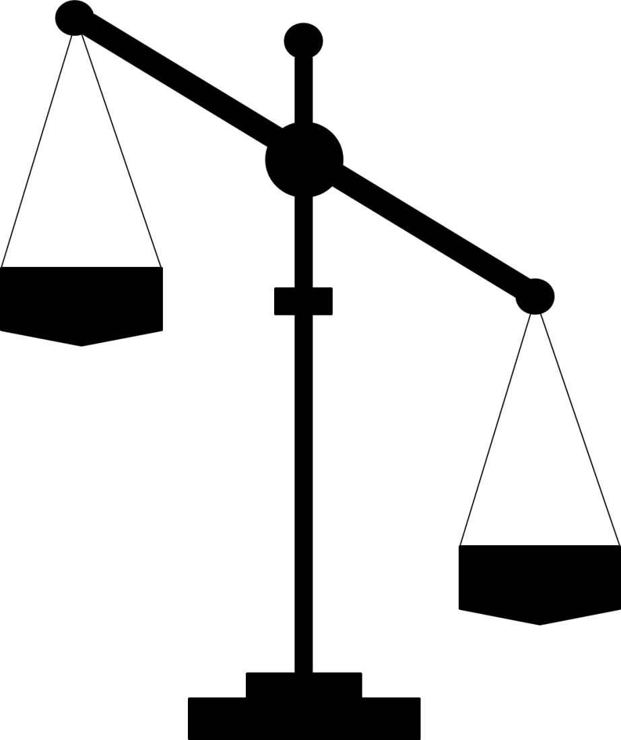
Why International Debt Court Works: A Fair and Transparent Arbitration Process (FTAP)
Fair, Independent and Neutral
Notes:
The policy term Jubilee USA is pushing for is called a Fair and Transparent Arbitration Process or FTAP. But lets make it real simple – I’m going to briefly describe why a court would work, and the guiding FTAP principles!
First of all, this court would be neutral. Currently, the system is lender controlled. The debtor has no control over the stipulations of relief or restructuring of debts, and the proceedings do not take into account the joint responsibility of the creditor in irresponsible loans. Assessments will not be made by any involved party, and the court will be independent of any international financial institution. Impartiality is key and will eliminate the power imbalance that currently exists.
18

Slide 19
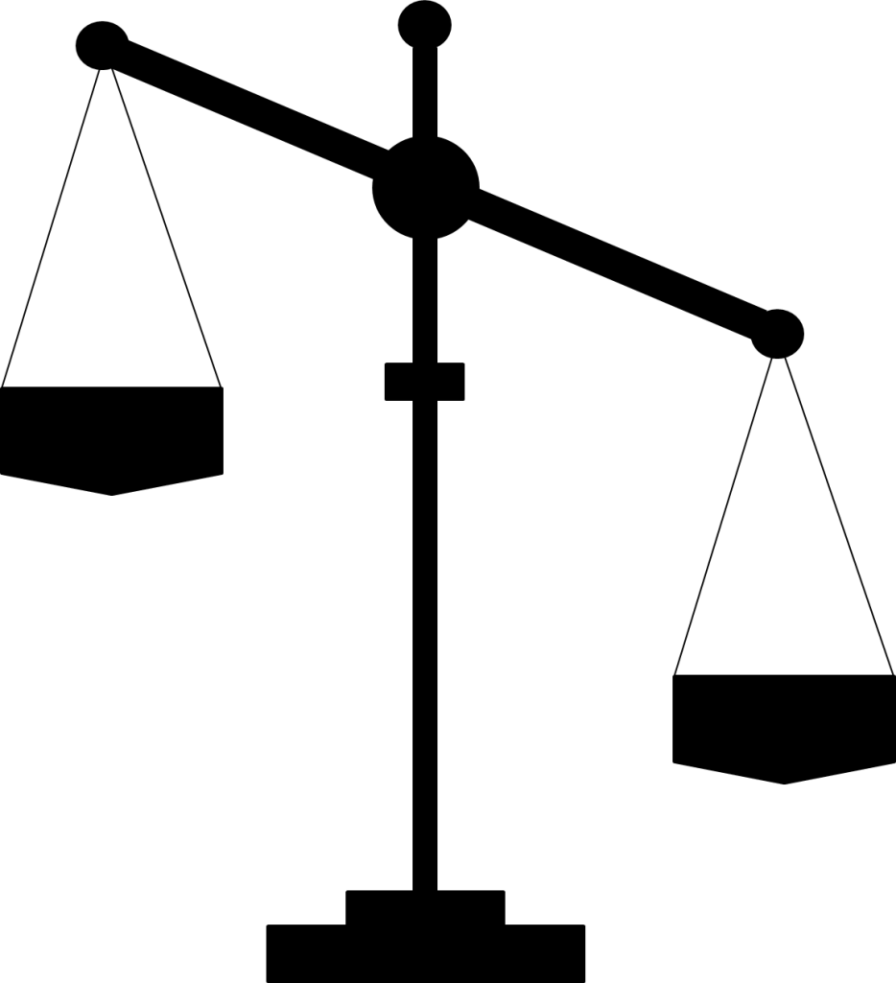
Why International Debt Court Works: A Fair and Transparent Arbitration Process (FTAP)
Flexible with current debt systems
Notes:
Second, the international debt court would be flexible with the current situation of any particular country. Currently the lending system does not take outstanding circumstances into consideration. There is no difference in how different nations may be experiencing debt --- is a nation recently getting over a long-term civil war or conflict? An earthquake or other disaster?
19

Slide 20
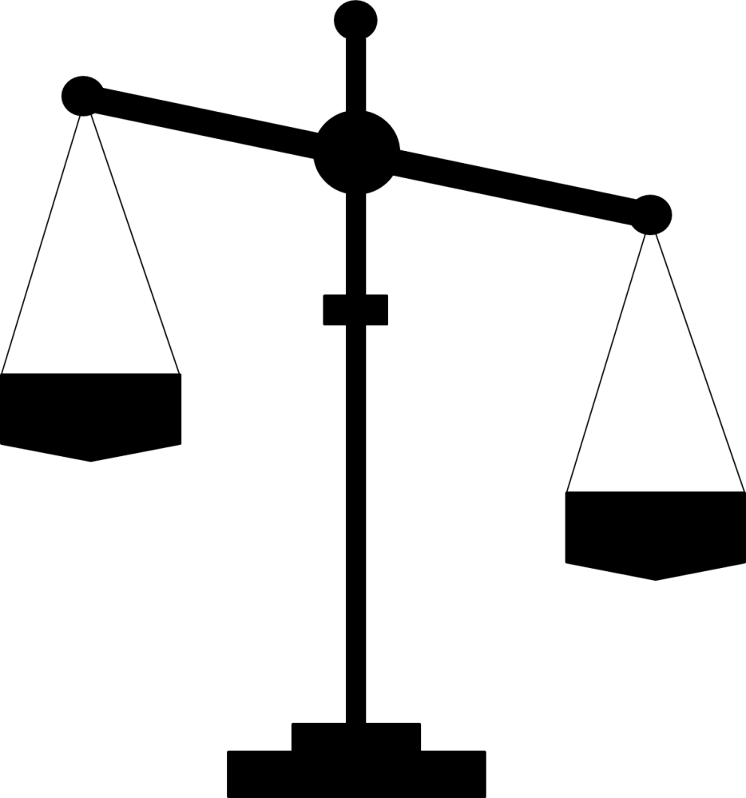
Why International Debt Court Works: A Fair and Transparent Arbitration Process (FTAP)
Addresses all forms of debt
Notes:
Third, the court would address all forms of debt from all creditors – whether it was the international financial institutions or private bankers -- all creditors would have to abide by these rules. The court would also take into consideration, which parts of the debt were odious and illegitimate. Was the money spent on investments other than for the benefit of the people? Did it include arms, fund extravagant lifestyles of the political elites and/or oppress the people and democracy?
The international debt court will also consider unsustainable debt, which is money that can’t be paid back or can only be paid back at huge expense to public investment and social services. We have to remember that when dictators or other nations take loans that do not benefit the people of a nation, or loans that impede on needs to address extreme poverty, that it is not the citizens’ fault. But it is they, not their irresponsible or repressive governments, who suffer.
20

Slide 21
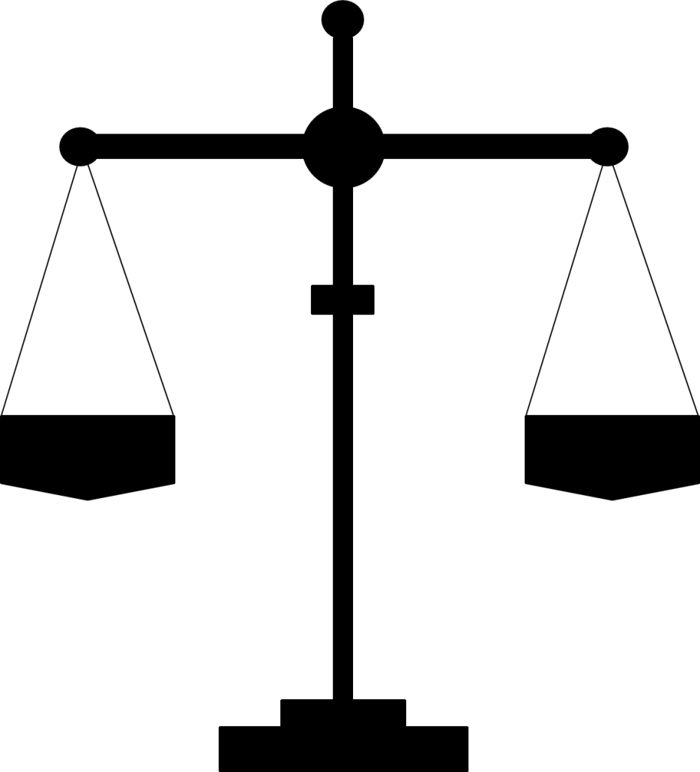
Why International Debt Court Works: A Fair and Transparent Arbitration Process (FTAP)
Structural solution to international debt crisis
Notes:
Finally, this court can serve as a structural solution to the international debt crisis. It can provide an arena for all debts to be addressed, rather than setting up individual spaces and conditions for various countries differently. Therefore, the court and guiding FTAP principles could deal with the debt crises ranging from Egypt to Zimbabwe to Greece, while still giving a custom solution to each country. It could address each problem and support just solutions.
21

Slide 22

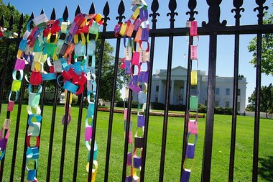
Sign the petition
Spread the word
Join the Jubilee movement
Notes:
Hopefully, after this presentation you have a better understanding of the issues of debt around the world. Perhaps some of your opinions that you expressed during the four corners exercise have changed or you have an even better understanding!
I’m passing around a petition as well as a one page grassroots resource which reiterates the information on the G8/G20 and the call for a new mechanism, guided by FTAP and the principles just discussed, to be developed towards an international debt court. Please sign the petition to support this important cause!
And just as importantly, remember that when you sign this petition right here, you join millions of others around the world who have and continue to fight to end poverty and move towards a more just world in the Global Jubilee Movement!
(This is also a great time, if you plan on getting more involved with Jubilee to set up a time to meet with interested people!)

Slide 23
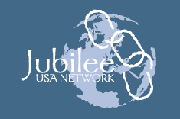
joining hands to break the chains of debt

